Slide 1
SystemVerilog HDL Workshop #2
044252 - Digital Systems and Computer Structure

Slide 2
Agenda
SystemVerilog building blocks:
Values / number representation
Operators
Module implementation
Concurrent assignments
Procedural blocks
Parameters
Parallelism in HDL
Common mistakes

Slide 3
Agenda
SystemVerilog building blocks:
Values / number representation
Operators
Module implementation
Concurrent assignments
Procedural blocks
Parameters
Parallelism in HDL
Common mistakes

Slide 4
Integer Literals in SystemVerilog
<width'><signed><radix> value (”<>” indicates optional part)
Defaults
Width = 32
Unsigned
Radix = Decimal
Number of
bits
s,S – Signed
(Two’s
complement)
Binary → b or B
Octal → o or O
Decimal → d or D
Hexadecimal → h or H
Consecutive chars
0-f, x, z

Slide 5
Integer Literals in SystemVerilog
<width'><signed><radix> value
1'b0
one bit with an unsigned value of zero
8'hFF
8 bits with an unsigned value of 0xFF (or 255 in decimal)
14
32 bits with an unsigned value of 14 in decimal
-14
32 bits with a signed value of -14

Slide 6
Integer Literals in SystemVerilog
<width'><signed><radix> value
4'sb1011
4 bits with a signed value of -5
12'b1010_1101_0001 = 12'hAD1
12 bits with an unsigned value of 2769 (underscores are ignored)

Slide 7
A Correction from Last Time
Question: What does this do?
Answer: Unsigned extension
logic [7:0] out; logic [3:0] A; out = {{4{0}}, A[3:0]};

Slide 8
A Correction from Last Time
Question: What does this do?
Answer: Unsigned extension
logic [7:0] out; logic [3:0] A; out = {{4{1'b0}}, A[3:0]};

Slide 9
Agenda
SystemVerilog building blocks:
Values / number representation
Operators
Module implementation
Concurrent assignments
Procedural blocks
Parameters
Parallelism in HDL
Common mistakes

Slide 10
Bitwise Operators (i)
& → bitwise AND
| → bitwise OR
~ → bitwise NOT
^ → bitwise XOR
~^ or ^~ → bitwise XNOR
Operation on bit by bit basis

Slide 11
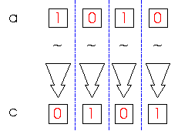
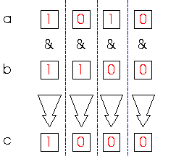
Bitwise Operators (ii)
c = ~a;
c = a & b;
a = 4'b1010;
b = 4'b1100;
c = a ^ b;
a = 4'b1010;
b = 2'b11;

Slide 12
Shift
>> → shift right
<< → shift left
a = 4'b1010;
b = a << 2; // b = 4'b1000
c = a >> 1; // c = 4'b0101

Slide 13
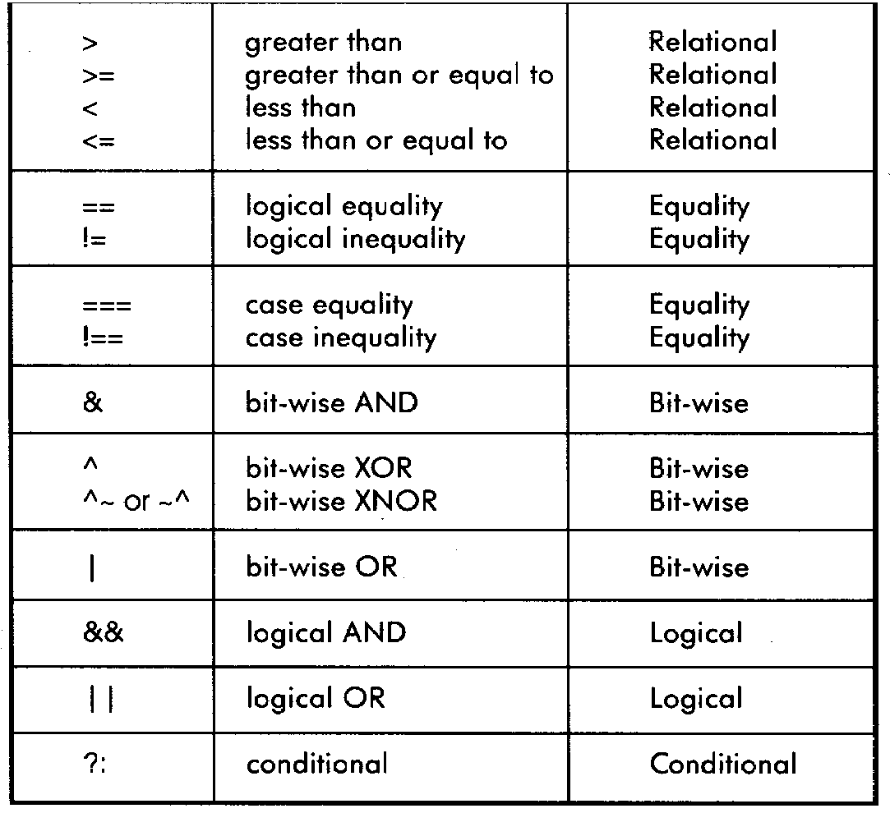
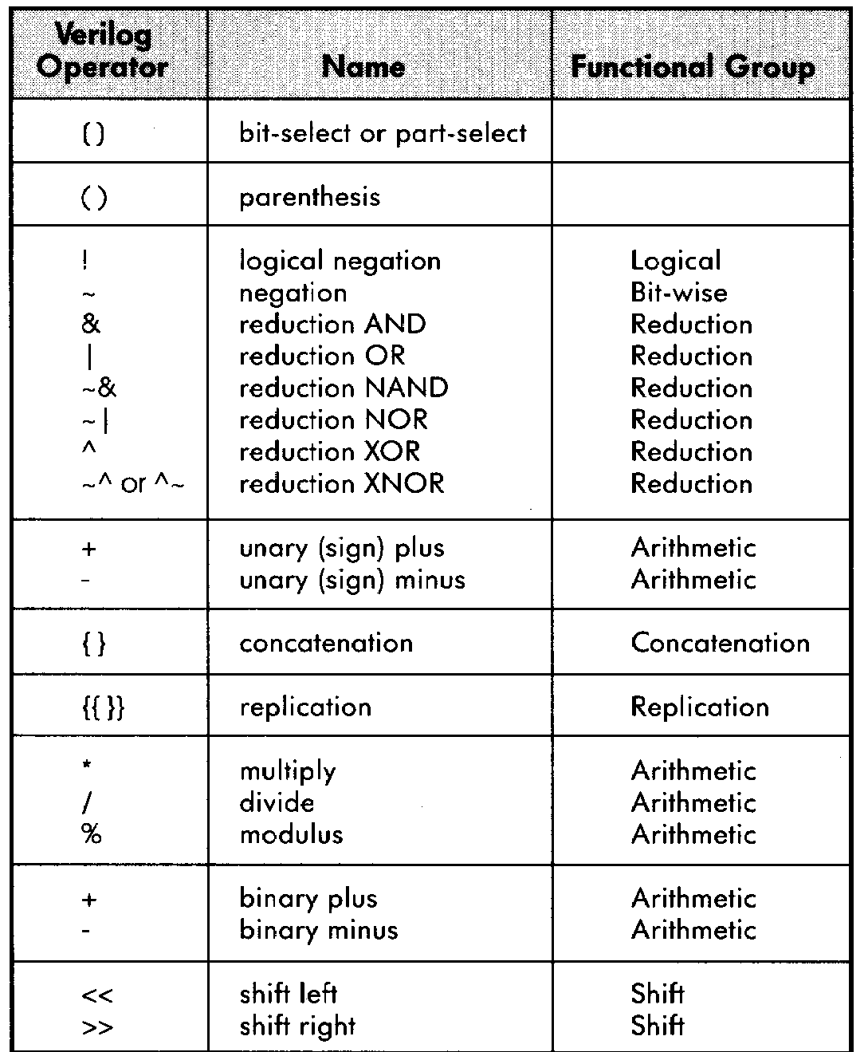
SystemVerilog Operator Precedence

Slide 14
Agenda
SystemVerilog building blocks:
Values / number representation
Operators
Module implementation
Concurrent assignments
Procedural blocks
Parameters
Parallelism in HDL
Common mistakes

Slide 15
Module Implementation
There are 3 ways to implement hardware inside a module:
Module instantiation
Concurrent assignments
Procedural blocks – “Processes”

Slide 16
2. Concurrent Assignments
Connect a wire to a combinational logic or another wire
When the right-hand-side of an assignment changes, it immediately flows through to the left-hand-side wire
Syntax:
logic signal;
assign signal = 1'b0;
logic signal1;
logic signal2;
assign signal2 = signal1;

Slide 17
Concurrent Assignment Example #1
module buffer_module (
output logic Z,
input logic A
);
assign Z = A;
endmodule

Slide 18
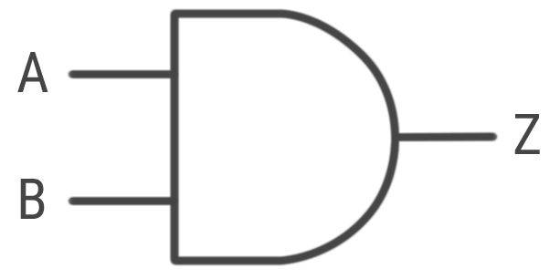
Concurrent Assignment Example #2
module and_module (
output logic Z,
input logic A,
input logic B
);
assign Z = A & B;
endmodule

Slide 19
Concurrent Assignment Example #3
module logic_module (
output logic Z,
input logic A,
input logic B,
input logic C
);
assign Z = (A & B) | C;
endmodule

Slide 20
Module Implementation
There are 3 ways to implement hardware inside a module:
Module instantiation
Concurrent assignments
Procedural blocks – “Processes”

Slide 21
3. Procedural Blocks
Sequential: all statements inside the block are executed sequentially
One line after the other
Two procedural constructs:
initial
always_comb

Slide 22
Procedural Blocks – Initial Statement
initial statement is executed only once. We will use it only in simulations.
Syntax:
initial begin
<statement1>;
# time_to_wait
<statement2>;
# time_to_wait
...
end

Slide 23
Procedural Blocks – Initial Statement Example
module mymodule_tb;
logic a;
logic out;
mymodule uut (
.a(a),
.out(out)
);
initial begin
a = 1'b0;
5#
a = 1'b1;
5#
a = 1'b0;
end
endmodule

Slide 24
Procedural Blocks – always_comb Statement
always_comb statement: executes in a loop. Used for combinational logic implementation.
Syntax:
always_comb begin
<statement1>;
<statement2>;
...
end

Slide 25
Procedural Blocks – always_comb Statement Example
module and_module (
output logic Z,
input logic A,
input logic B
);
always_comb begin
Z = A & B;
end
endmodule
Note: no assign!

Slide 26
Another Example - Shift
module shift_module (
output logic [3:0] out,
input logic [3:0] a
);
always_comb begin
out = a << 2;
end
endmodule

Slide 27
Agenda
SystemVerilog building blocks:
Values / number representation
Operators
Module implementation
Concurrent assignments
Procedural blocks
Parameters
Parallelism in HDL
Common mistakes

Slide 28
Parameters
Allow per-instantiation module parameters
Use “parameter” statement
Syntax:
Module Declaration:
Module Instantiation:
module module_name (
output logic out1,
...,
input logic in1
);
parameter param1 = 1;
parameter param2 = 2;
parameter param3 = 3;
...
endmodule
module_name #(
.param1(value1),
.param2(value2),
.param3(value3)
) instname (
.in1(in1),
...
.out1(out1)
;(

Slide 29
Parameters: Example
module shifts (
output logic [3:0] b,
output logic [3:0] c,
input logic [3:0] a
);
shift_N #(
.N(2)
) shift_inst1 (
.a(a),
.out(b)
;(
shift_N #(
.N(3)
) shift_inst2 (
.a(a),
.out(c)
;(
endmodule
module shift_N (
output logic [3:0] out,
input logic [3:0] a
);
parameter N = 1;
always_comb begin
out = a << N;
end
endmodule

Slide 30
Example for using Parameters in the Wet Exercise
Using a logic gate with a propagation delay:
module AND2 (
output logic Z,
input logic A,
input logic B
);
parameter Tpdhl = 1;
parameter Tpdlh = 1;
...
endmodule
module my_module (...);
...
AND2 #(
.Tpdhl(2), .Tpdlh(3)
) and_ist (
.Z(and_out),
.A(a),
.B(b)
);
endmodule
Unless stated otherwise, the hardware is ideal (Tpd = 0)!

Slide 31
Local Parameters
Contain constant values
Cannot be assigned during instantiation - not to be confused with parameters
Syntax:
Example:
localparam <param_name> = <param_value>;
module my_module (...);
localparam N = 2'b11;
localparam NUM_OF_CYCLES = 10;
...
endmodule

Slide 32
Agenda
SystemVerilog building blocks:
Values / number representation
Operators
Module implementation
Concurrent assignments
Procedural blocks
Parameters
Parallelism in HDL
Common mistakes

Slide 33
Parallelism in HDL
Hardware Description Language describes hardware
Each of the 3 ways to implement a module describes a hardware part of the module
All hardware parts “live” concurrently!
Statements in a module (outside of procedural blocks) simply define existence and not executed sequentially
The order of appearance is not important

Slide 34
Examples of Parallelism in HDL
module my_module (
output logic a,
output logic b
);
assign a = 1'b0;
assign b = 1'b0;
assign a = 1'b1;
endmodule
Compilation Error

Slide 35
Examples of Parallelism in HDL
module my_module (
output logic c
);
logic a;
logic b;
assign c = a | b;
assign a = 1'b0;
assign b = 1'b1;
endmodule
c = 1'b1

Slide 36
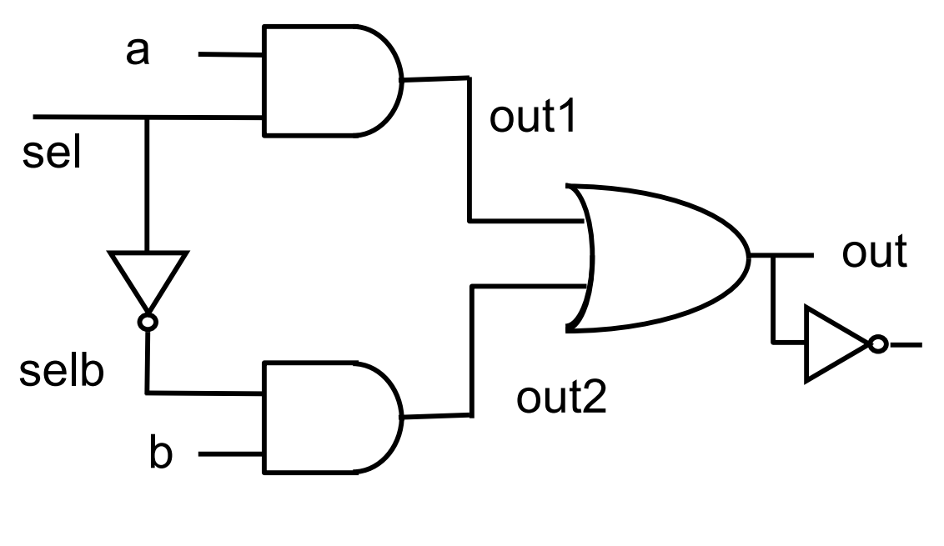
Combinational Example: Mux Implementation
in
In[0]
2
In[1]
outn

Slide 37
Combinational Example : Mux Implementation
module mux (
output logic out,
output logic outn,
input logic [1:0] in,
input logic sel
);
logic out1, out2, selb;
and a1 (out1, in[0], sel);
not i1 (selb, sel);
and a2 (out2, in[1] , selb);
always_comb begin
out = out1 | out2;
end
assign outn = ~out;
endmodule
in
In[0]
2
In[1]
outn

Slide 38
System Tasks
$display: prints arguments in the console window
$time: gives the simulation time
$stop: stops the simulation

Slide 39
System Tasks - Example
module and_module (
output logic c,
input logic a,
input logic b
);
assign c = a & b;
endmodule
module and_module_tb;
logic a;
logic b;
logic c;
and_module and_module_inst(.a(a), .b(b), .c(c));
initial begin
a = 1'b0;
b = 1'b1;
$display("%t: a = %d, b = %d, c = %d", $time, a, b, c);
$stop;
end
endmodule

Slide 40
Agenda
SystemVerilog building blocks:
Values / number representation
Operators
Module implementation
Concurrent assignments
Procedural blocks
Parameters
Parallelism in HDL
Common mistakes

Slide 41
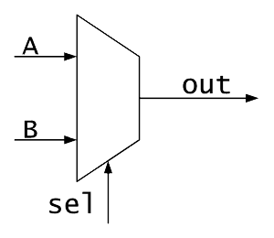
Common Mistake #1 – Thinking a Module is a Function Call
module my_module(...);
...
logic w;
mux2to1 mux0 (.sel(sel), .A(a1), .B(b1), .out(w));
endmodule
a1
This is instantiation, not a function call!
w
b1

Slide 42
Common Mistake #2 – Connecting Wires
module my_module(...);
...
logic w;
mux2to1 mux0 (.sel(sel), .A(a1), .B(b1), .out(w));
mux2to1 mux1 (.sel(sel), .A(a2), .B(b2), .out(w));
endmodule
w
w
a1
b1
w
a2
b2
The same wire cannot be connected to two different module outputs!

Slide 43


Common Mistake #2 – Connecting Wires
module my_module(...);
...
logic w;
logic a;
logic b;
assign w = a & b;
assign w = a | b;
endmodule
a
b
w
a
b
The same wire cannot be connected to two different gate outputs!

Slide 44
Common Mistake #2 – Connecting Wires
module my_module(...);
...
logic w;
logic a;
logic b;
always_comb begin
w = a & b;
end
always_comb begin
w = a | b;
end
endmodule
a
b
w
a
b
The same wire cannot be connected to two different gate outputs!

Slide 45
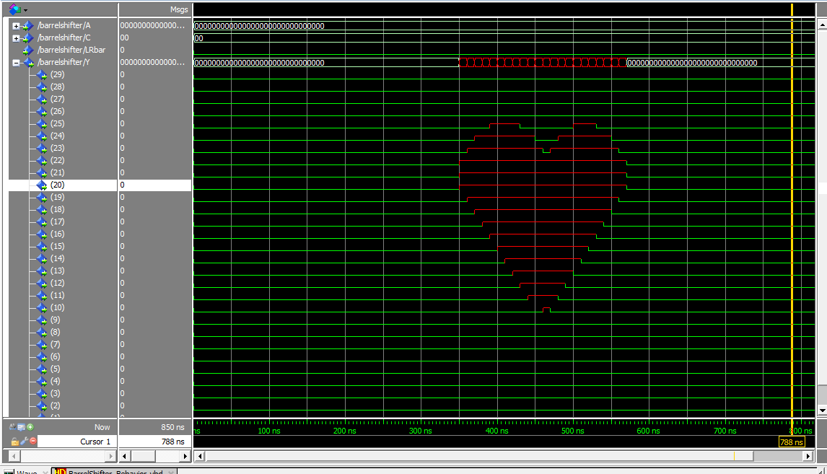
Common Mistake #2 – Connecting Wires
Collision may cause ‘x’ values in simulation

Slide 46

Common Mistake #3 – Wrong Debugging
module my_module(...);
...
logic w1;
logic w2;
mux2to1 mux0 (.sel(sel), .A(a1), .B(b1), .out(w1));
mux2to1 mux1 (.sel(sel), .A(a2), .B(b2), .out(w2));
endmodule
my_module
a1
w1
b1
a2
w2
b2
When there are bugs, check internal modules first!

Slide 47
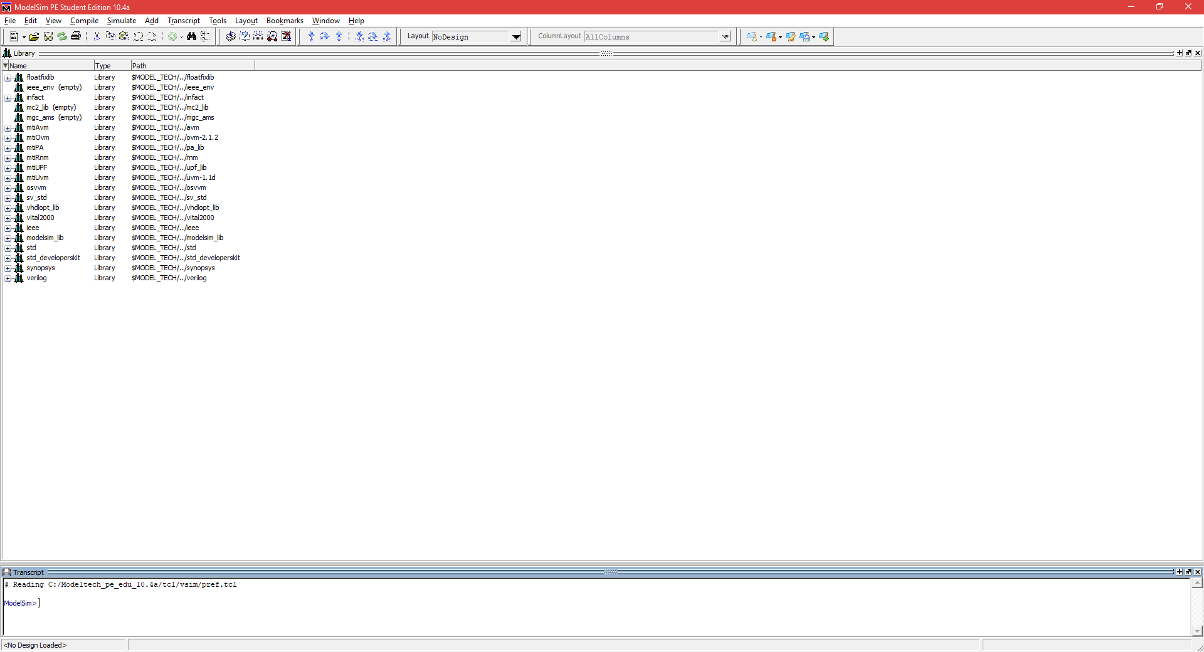
Common Mistake #4 – Not Being a ModelSim Superuser
Use the command line

Slide 48
More Common Mistakes
Can be found in the FAQ file in the Moodle course website

Slide 49
Writing Code in SystemVerilog
Use your favorite text editor to implement your design
Notepad++ is recommended
Every module is in a separate file that has the name of the module
e.g., my_module.sv implements my_module
my_module.sv
module my_module (...);
// Implementation
endmodule

Slide 50

How to Debug Your Code?
Add all the relevant signals to the waveform
Check all the relevant inputs/special cases
If you can’t check all – check special cases
Look for suspicious behavior
Signals with ‘x’ value: did you forget to initialize them? Is it a collision? Or does it make sense? (Tpd, …)
Signals with ‘z’ value: probably forgot to connect a wire

Slide 51
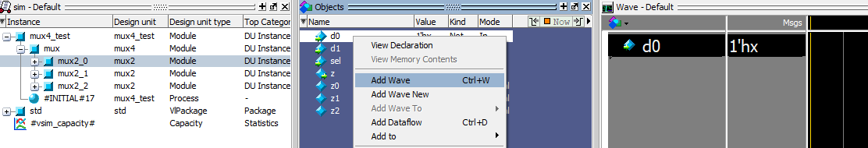
How to Add Internal Signals to the Waveform?
3. The signal will be added to the waveform
1. Navigate to the module instance in the “sim – Default” window and mark it
2. In the “Objects” window, Right click on the relevant signal and choose “Add Wave”

Slide 52

Wet Exercise 1
You will be required to:
Implement modules using a given logic gate library
Simulate them
The workshops cover all the syntax needed to solve the wet exercises

Slide 53
Workshop #2 Cheat Sheet
Integer literals:
<width'><signed><radix> value
Bitwise operators:
&, |, ~, ^, ~^
Shift: <<, >>
Concurrent assignments:
logic signal1, signal2, signal3;
assign signal3 = signal1 | signal2;

Slide 54
Workshop #2 Cheat Sheet
Initial:
always_comb:
initial begin
<statement1>;
# time_to_wait
<statement2>;
# time_to_wait
...
end
always_comb begin
<statement1>;
<statement2>;
...
end

Slide 55
Workshop #2 Cheat Sheet
Parameter:
Local parameter:
parameter param1 = 1;
localparam param1 = 1;

Slide 56
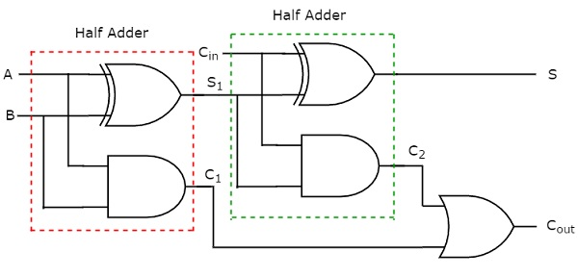
Full Adder Implementation using Two Half Adders

Slide 57

Questions?

